Slide 1
Miracles, Healing, Tongues, & Interpretation
Dr. Rick Griffith • Singapore Bible College
BibleStudyDownloads.org

Slide 2
What are Miracles?
Finding a parking lot during lunch time in city area?
Finishing your deadline on time?
Finding your precious lost item?
All of the above
None of the above

Slide 3
Miracles vs
The Gift of Miracles

Slide 4
Questions to Address on Miracles
What is the biblical definition of miracles?
What are their purposes?
What are the various views on the gift of miracles?
What are their implications?

Slide 5
The Biblical Gift of Miracles
36

Slide 6
Definition
36

Slide 7
Definition
36
du,namij (dunamis) 1 Cor. 12:10
an act displaying great power,
especially divine power.
te,raj (teras) Heb. 2:4
an event (wonder) that causes people to be amazed or astonished.
shmei/on (semeion) Acts 4:16
a sign; something that points to or indicates something else, especially God's activity and power.

Slide 8
Definition
36
Often "wonders and signs" is used as a stock expression to refer to miracles
(Exod. 7:3, Acts 2:43; 4:30; 5:12, etc)
Sometimes all three terms are combined,
"mighty works and wonders and signs" (Acts 2:22) or
"signs and wonders and mighty works"
(2 Cor. 12:12; Heb. 2:4)

Slide 9

Definition
36
"[The gift of performing]
an event of supernatural power [du,namij],
palpable to the sense [te,raj],
accompanying the servant of the Lord
to authenticate the divine commission [shmei/on]"
Dr. Leslie B. Flynn

Slide 10
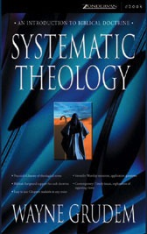
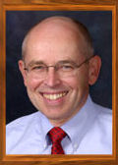
Definition
"A miracle is a less common kind
of God's activity in which he arouses
people's awe and wonder and
bears witness to Himself."
Dr. Wayne A. Grudem

Slide 11
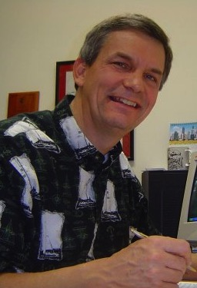
Definition
36
The miracle (dunamis) results in wonder where people marvel (teras)
for the purpose of
an authenticating sign (semeion).
Dr. Rick Griffith

Slide 12
Purposes
Authenticate the message of the gospel (John 3:2)
To bear witness to the fact that the kingdom of God has come and has begun to expand its beneficial results into people's lives (Matt. 10:6-8)
To help those who are in need (Matt. 20:30)
To remove hindrances to people's ministries (Matt. 8:15)
To bring glory to God (Matt. 9:8)

Slide 13
Examples
36
Miracles in the Bible
JESUS | APOSTLES
Miracles & People Healing Peter's mother-in-law (Matt. 8:14-15) Healing a leper (Matt. 8:1-3) Healing a centurion's servant (Matt. 8:5-13) Healing a paralytic (Mark 2:1-12) Raising a widow's son (Luke 7:11-17) Healing two blind men (Matt. 9:27-31) Healing 10 lepers (Luke 17:11-19) Miracles & Demons Healing the Gerasene Demoniac (Mark 5:1-13) Healing a mute demoniac (Matt. 9:32-33) Healing a demoniac girl (Mark 7:24-30) Healing a demoniac boy (Matt. 17:14-21) Miracles & Nature Changing water into wine (John 2:1-11) Calming the stormy sea (Matt. 8:23-27) Feeding 5000 men and their families (Matt. 14:16-21) Walking on water (John 6:16-21) Catching many fish (John 21:4-11) Withering of the fig tree (Matt. 21:18-22) | Miracles & People Peter raises the disciple Tabitha (Acts 9:36-42) Peter heals the lame man at the Temple gate (Acts 3:1-16) Ananias cures Saul of his blindness (Acts 9:17-18) Ananias & Sapphira struck dead at Peter's feet (Acts 4:5-11) Peter's shadow healing people (Acts 5:15) Paul's handkerchief heals people (Acts 19:11-12) Miracles & Demons Paul exorcises girl possessed of divining spirit (Acts 16:16-18) Apostles healing unclean spirits (Acts 5:16) Paul's handkerchief casts evil spirits out (Acts 19:11-12) Miracles & Nature NIL

Slide 14
3 Viewpoints
14

Slide 15
3 Viewpoints
15
CESSATIONIST Some gifts were temporary and some permanent (View held by Reformed & Dispensationalists)
Position: No miraculous gifts of the Holy Spirit exist today. Gifts such as prophecy, healing, miracles and tongues were confined to 1st century, a time when the apostles were establishing churches and the NT was not yet complete.
Wayne Grudem, et al, Are Miraculous Gifts for Today?
– Four Views (Grand Rapids, MI: Zondervan, 1996), 10.

Slide 16
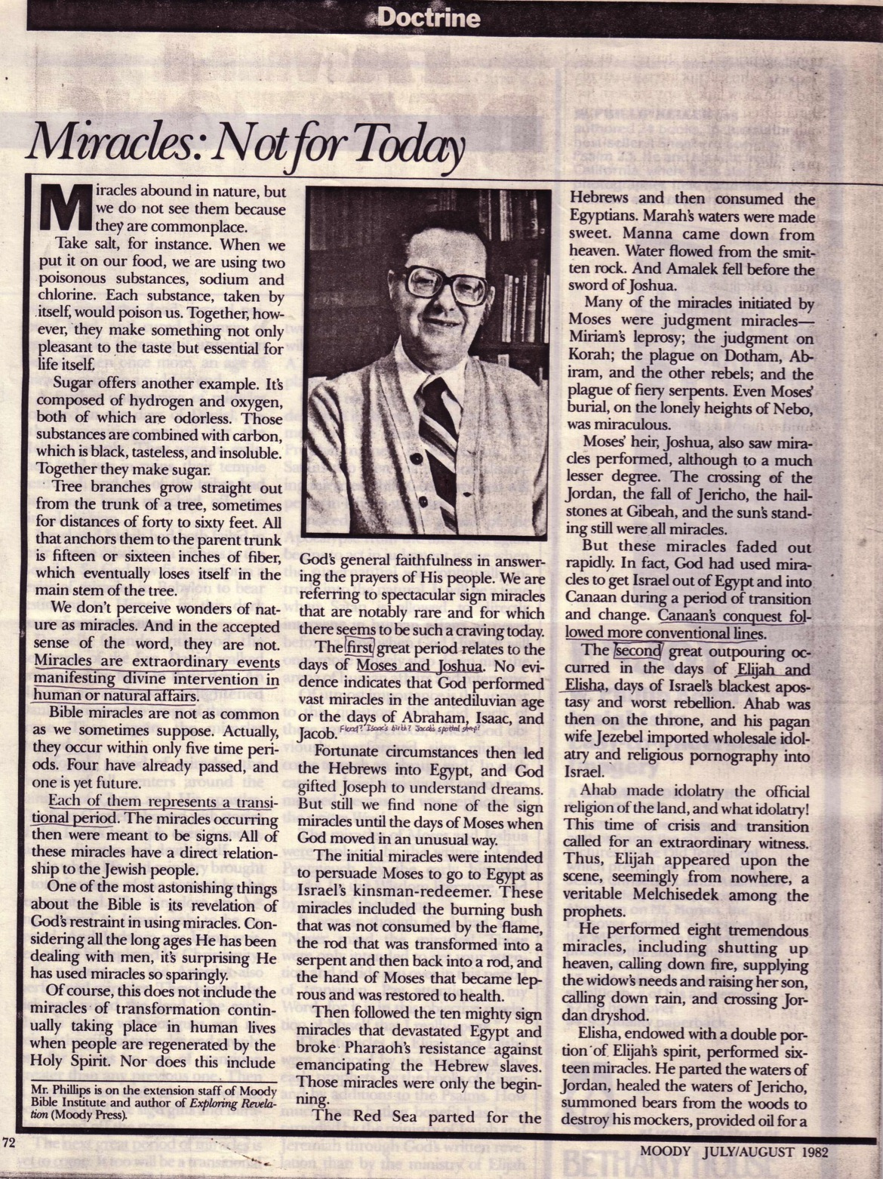
Do miracles happen today?
36
Some say no miracles occur today

Slide 17
3 Viewpoints
OPEN BUT CAUTIOUS View held across segments of evangelicals
Position: Open to the possibility of miraculous gifts today but cautious because of the abuses seen in the groups that practice them.
Wayne Grudem, et al, Are Miraculous Gifts for Today?
– Four Views (Grand Rapids, MI: Zondervan, 1996), 12-13

Slide 18
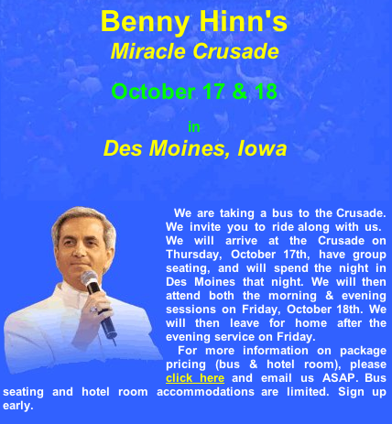
Do miracles happen today?
Some say no
Others are open but cautious
Still others believe the gift exists

Slide 19
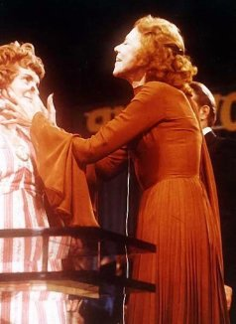
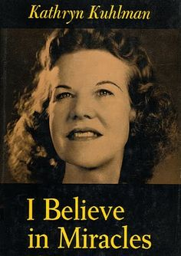
Kathryn Kuhlman
Notes:
She was known as the “best of the best” of the 20th century faith healers. A reporter once asked her to provide the ten best examples of those healed in her crusades. After looking up these ten people, not one of them was an example of a genuine physical healing that lasted. Some reverted to their sickness, some were psychosomatic, and none of them were genuine. Kuhlman herself claimed not to have the biblical gift of healing as she knew that many whom she prayed for did not get healed, unlike those in the NT who regularly succeeded in healing others.

Slide 20
3 Viewpoints
14
NON-CESSATIONIST All gifts are permanent (View held by Pentecostals and Charismatics and Third Wave)
Position: All the gifts mentioned in the NT are for today, including the gifts of prophecy, healing, miracles, tongues, interpretation of tongues, and distinguishing between spirits.
Wayne Grudem, et al, Are Miraculous Gifts for Today?
– Four Views (Grand Rapids, MI: Zondervan, 1996), 11-12

Slide 21
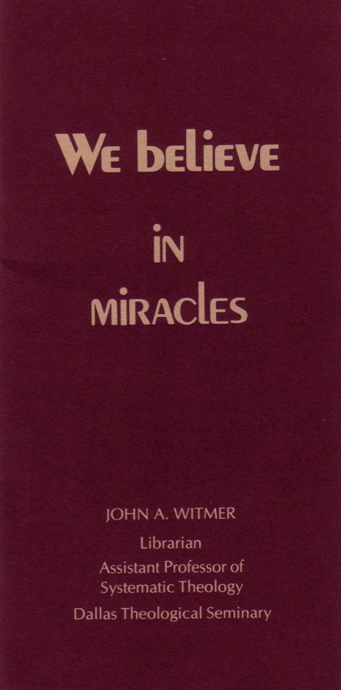
Do miracles happen today?
36
Some say no miracles occur today
Others believe the gift exists
I think the gift was temporary but God still does miracles as He wills

Slide 22
3 Viewpoints
16
Interpretation of 1 Corinthians 13:8-13
Cessationist | Open but Cautious | Non-Cessationist
Two different views of 1 Cor. 13:8-13: 1 Cor. 13:8-13 does not specify when gifts will cease. to teleion means "mature." | 1 Cor. 13:8-13 (and Eph. 2:20) does not explicitly teach cessation during the church age because Paul was expecting the imminent return of Christ (i.e., within his lifetime). | 1 Cor. 13:8-13 teaches that cessation will occur at the time of Christ's return.
Grudem, et al, Are Miraculous Gifts for Today?, 55-56, 123-124;
Grudem, Systematic Theology (Grand Rapids, MI: Zondervan, 1994), 1033.

Slide 23
3 Viewpoints
16
Interpretation of 1 Corinthians 12:28
Cessationist | Open but Cautious | Non-Cessationist
The gift of apostleship, which is clearly implied in 1 Cor. 12:28, did cease. Therefore, possible for the miraculous gifts to cease. | 1 Cor. 12 does not explicitly teach the continuance of miraculous gifts since they are listed alongside those gifts that formed the foundational ministry of the church (Eph. 2:20). | Sees "apostles" in 1 Cor. 12:28 (also Eph. 4:11) as an office and not as a spiritual gift.
Grudem, et al, Are Miraculous Gifts for Today?, 45, 120, 156-158;
Grudem, Systematic Theology, 1020.

Slide 24
3 Viewpoints
16
Purpose(s) of the miraculous gifts[S1/2]
Cessationist | Open but Cautious | Non-Cessationist
As documented in Acts, the gifts were given to authenticate the divine origin of the apostolic message in the spread of the gospel by the apostles and others while the canon was not yet complete (see Heb. 2:3-4; 2 Cor. 12:12). |  | Authentication was only one of the purposes. Others include evangelistic (Acts 9:32-43), helping those who are in need (Matt. 14:14; Mark 1:40-41), bringing glory to God (John 9:3).
Grudem, et al, Are Miraculous Gifts for Today?, 42, 124; 191;
Grudem, Systematic Theology, 359-362;
Edgar, "The Cessation of the Sign Gifts," Bibliotheca Sacra 145 (Oct-Dec 1988): 382.

Slide 25
3 Viewpoints
16
Purpose(s) of the miraculous gifts[S2/2]
Cessationist | Open but Cautious | Non-Cessationist
Once the church was established on the foundation of the apostles and prophets, the gift of apostleship and prophecy and their accompanying authenticating miraculous gifts passed away (Eph. 2:11-21). | The NT does not explicitly teach that certain miraculous gifts will cease. Neither does it explicitly teach that they will continue throughout the church age. | Another primary purpose is to edify and build up the body of Christ, therefore the continuance of gifts is necessary for the church today. Further, not only apostles exercised the gift of miracles.
Grudem, et al, Are Miraculous Gifts for Today?, 42, 124; 191;
Grudem, Systematic Theology, 359-362;
Edgar, "The Cessation of the Sign Gifts," Bibliotheca Sacra 145 (Oct-Dec 1988): 382.

Slide 26
3 Viewpoints
16
Interpretation of History
Cessationist | Open but Cautious | Non-Cessationist
History shows that miraculous gifts did cease for centuries soon after the apostolic times. Non-cessationists fail to discharge burden of proving existence today. Today's gifts do not meet biblical criteria from NT. | The witness of church history that miraculous activity of the quality and extent associated with the era of Christ and the apostles is not found as a continuing phenomenon in the later church. | Although healing and miracles today may not be at same level of the apostles, this does not mean it ceased. Seriousness of diseases and strength of gifts can vary. Biblical examples and criteria cannot be applied strictly.
Edgar, "Cessation," 372-379; Grudem, et al., Are Miraculous Gifts for Today?, 113, 159; Grudem, Systematic Theology, 1023; Deere, Surprised by the Power of the Spirit (Grand Rapids, MI: Zondervan, 1993), 67.

Slide 27
Are miracles needed in our modern age?
What do you think?

Slide 28
Critique

Slide 29
Critique
16-17
1 Cor. 13:8-13 does not teach the cessation or continuation of miraculous gifts.
  Is Paul arguing when these gifts will cease?
  Paul's emphasis: comparing "enduring quality of love" vs. "imperfect understanding" brought through these gifts.
  The "perfect" understanding comes when we are "face-to-face" with God, pointing to the understanding of the content by means of the gifts and says nothing said about the gifting.
NO.

Slide 30
Critique
16-17
1 Cor. 13:8-13 (RSV, used by Grudem, Systematic Theology, 1032)
8 Love never ends; as for prophecies, they will pass away; as for tongues, they will cease; as for knowledge, it will pass away.
9 For our knowledge is imperfect and our prophecy is imperfect;
ek merous ek merous
ESV → "in part" "in part"
10 but when the perfect comes, the imperfect will pass away.
to teleion to ek merous
"perfect" "partial"
11 When I was a child, I spoke like a child, I thought like a child, I reasoned like a child; when I became a man, I gave up childish ways.
12 For now we see in a mirror dimly, but then face to face.
Now I know in part; then I shall understand fully, even as I have
ek merous
"in part" ← compared to → full understanding
been fully understood.
13 So faith, hope, love abide, these three; but the greatest of these is love.

Slide 31
Critique
18-20
The gift of apostleship did cease.
  Therefore, it is possible for a certain spiritual gift to cease.
  Non-cessationist: "apostles" is an office and not a spiritual gift.
    Response: Paul sees it as a spiritual gift by listing it with other gifts (1 Cor. 12:28).
  "[A spiritual gift] may be regarded as a gift
  and the job in which to exercise it,
  or a job and the gift with which to do it."
  John Stott (Baptism and Fullness, p. 113)

Slide 32
Critique
18
36
Gift of miracles given to authenticate the gospel message by the apostles and others during a time when the canon was not yet complete (cf. Heb. 2:3-4; 2 Cor. 12:12).
  It purpose parallels that of Jesus' miracles.
  When the church was established on "the foundation of the apostles and prophets" (Eph. 2:11-21) by the completion of the canon, the gift of apostleship and prophecy and their accompanying authenticating miraculous gifts passes away.

Slide 33
Critique
Church History:
Miraculous activity as a continuing phenomenon ≠ the quality and extent associated with Christ and the apostles.
  Non-cessationists: even if the miracles are "weaker" today, they nonetheless still serve to build-up the church (1 Cor. 12:7).
  However, it is difficult to distinguish a genuine divine miracle from a spurious or even a demonic one.

Slide 34
My Position
36
Regarding the gift of miracles today,
my position is…
CESSATIONIST
Regarding God doing miracles as He wills today, my position is…
NON-CESSATIONIST

Slide 35
Conclusion

Slide 36
Conclusion
Why Discern?
What is discernment?
  Christian discernment is the ability to distinguish biblical Christianity from the counterfeit spirituality and values of today's world
The church is called by God to be holy
  "… sanctify [the church] in the truth…" (John 17:15-17)
  Be a community of believers who embrace integrity, purity, and a passionate love for God
  If the call to holiness is to be obeyed, the church must have discernment
To have true discernment, one must begin with Scripture

Slide 37
Conclusion
"Not everyone who says to me,
Lord, Lord, will enter the kingdom of heaven,
but the one who does
the will of my Father who is in heaven.
On that day many will say to me,
Lord, Lord, did we not prophesy in your name,
and cast out demons in your name,
and do many mighty works in your name?
And then will I declare to them,
I never knew you; depart from me,
you workers of lawlessness."
(Matt. 7:21-23)

Slide 38
Warnings
A miracle is not necessarily from God just because…
… it is performed by one who calls Jesus "Lord"
  There are false Christs, false prophets, false apostles, etc. (Matt. 24:24; 2 Cor. 6:13-15)
… it helps people
  OT Egyptian magicians, modern miracles by other religions, etc. also help others
… the miracle worker seems to have assurance of heaven
  Do false prophets and miracle workers know they are deceived? Are all healings from God?

Slide 39
Conclusion
3 Principles
The gospel vs. miracles
  The power of Christianity is best seen in the gospel, not in physical miracles (1 Cor. 1:22-24)
  No church in the NT was judged for not doing more signs and wonders
Miracles as redemptive acts of God
  Miracles are not done on a regular basis
  No evidence that the unconverted will believe when they see miracles
No promises of instant healing
  It is true that Christ died for our souls and bodies.
  However, we will not see the fulfillment of bodily redemption until our resurrection to glory

Slide 40
Conclusion
3 Suggestions
A pastoral ministry
  Ministry to the oppressed - the poor, the battered, the jobless
  Ministry to the sick
A teaching ministry
  Older & more mature Christians should be examples to young believers
A prophetic ministry
  The church should speak out against evil & guard itself
  The church should test the teachings against Scripture

Slide 41
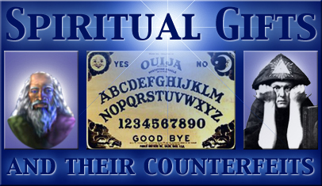
Can Some Miracles Be Counterfeit?

Slide 42
The Gift of Healing
37
Does God want all Christians healed of every disease?

Slide 43
Divine Healing Today
What should we do when we need physical healing?

Slide 44

AOG Official Doctrine
"Divine healing is an integral part of the gospel. Deliverance from sickness is provided for in the atonement, and is the privilege of all believers (Isaiah 53:4,5; Matthew 8:16,17; James 5:14-16)”
(The Assemblies of God Constitution in its Statement of Fundamental Truths, section 12, emphasis mine)
http://ag.org/top/beliefs/position_papers/4184_healing.cfm
Notes:
This statement on divine healing was adopted by the Assemblies of God General Presbytery, August 20, 1974 (http://ag.org/top/beliefs/position_papers/4184_healing.cfm)

Slide 45
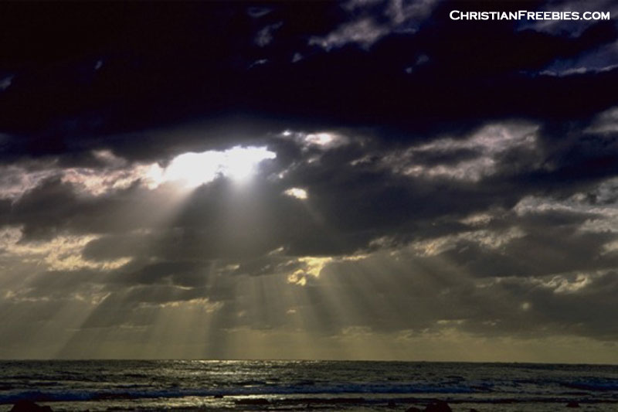
James 2:17
“In the same way,
faith by itself,
if it is not accompanied by action,
is dead.”
James 2:17

Slide 46

Sharing with Concern in James 5
Share in Possessions (1-6)
Share in Patience (7-12)
Share in Prayer (13-20)
Ron Blue, Bible Knowledge Commentary, 832-34

Slide 47

Pray, Pray, Pray
“Is any one of you in trouble? He should pray. Is anyone happy? Let him sing songs of praise. Is anyone sick? He should call the elders of the church to pray over him…” (James 5:13-14)

Slide 48

Five questions on James 5:14-15…
What kind of sickness?
What kind of anointing?
What's the prayer of faith?
Does this procedure always heal?
How does forgiveness come?

Slide 49
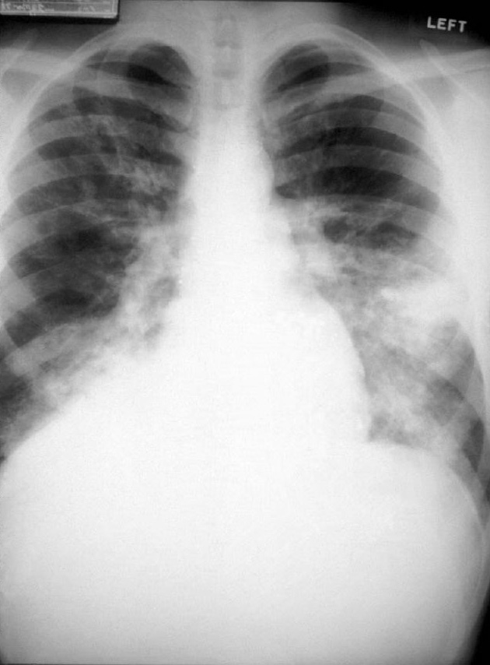

What Kind of Sickness?
Asthenei from avsqene,w
Weak Faith
Physical Illness
General word for “to be weak”
Used this way in many passages (e.g., Acts 20:35 “we must help the weak”)
James 5:15 better translated “make the weary person well” (cf. Heb. 12:3)
Contrasts with “in trouble” (5:13) by narrowing to physical issues
Need for elders
Use of oil
“restore” and “raise up” are physical

Slide 50


What Kind of Anointing?
Mundane
Sacred
General word for “to rub with oil”
Contrasts with a word not used, which is chrio (“ceremonially anoint”)
Greek participle shows that prayer, not anointing, is the primary act

Slide 51


Does the Prayer Work?
“the prayer will restore… and the Lord will raise him up”
Yes
No
Prayer that God will heal emotional wounds is always successful
God does not always heal physically when we pray

Slide 52

The Problem of Pain
If God is good and all-powerful, why does he allow his creatures to suffer pain?

Slide 53
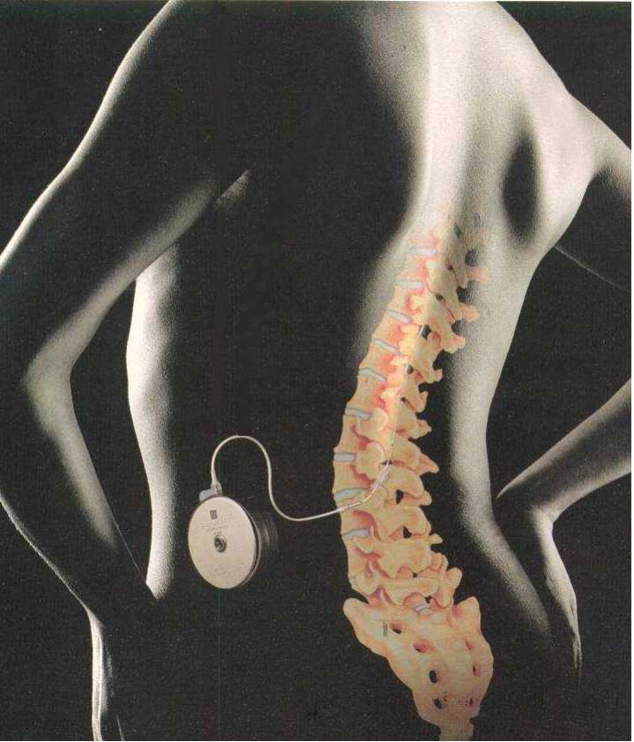
Pain Reveals God's Love
“Lewis asserts that pain is a problem because our finite, human minds selfishly believe that pain-free lives would prove that God loves us. In truth, by asking for this, we want God to love us less, not more than he does…”
www.apologetics.org/ public_html/products_prob...

Slide 54
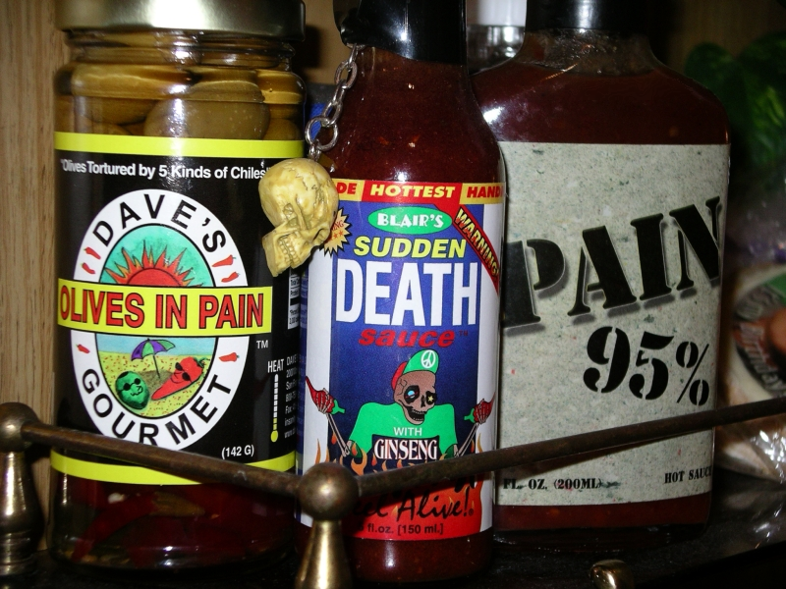
Pain Food

Slide 55

Christ understands suffering
“For we do not have a high priest who is unable to sympathise with our weaknesses, but we have one who has been tempted in every way, just as we are – yet was without sin. Let us then approach the throne of grace with confidence, so that we many receive mercy and find grace to help us in our time of need.”
Hebrews 4:15-16

Slide 56

What's the road to healing?

Slide 57
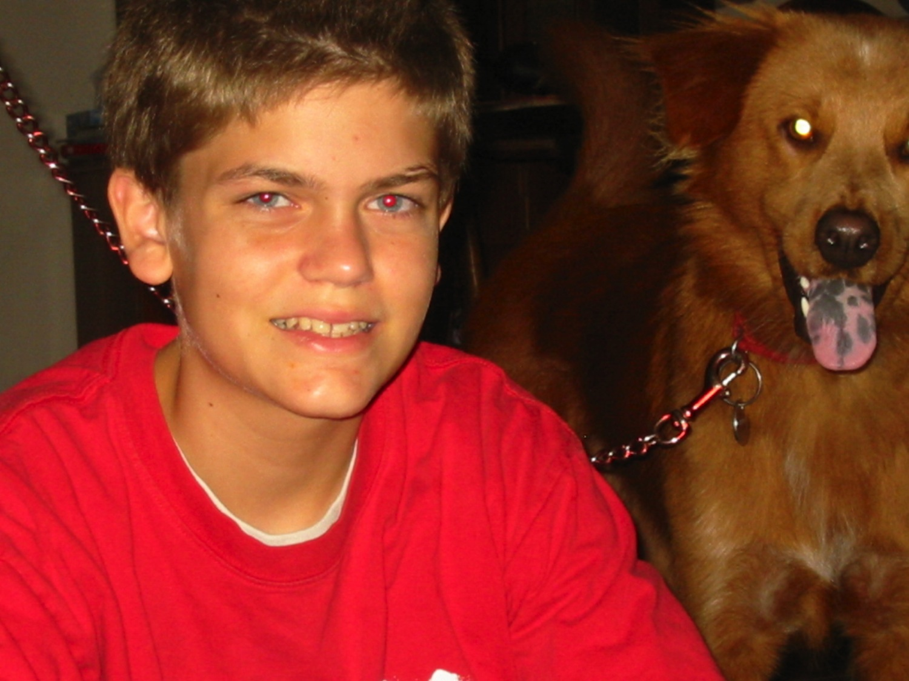
Our son Stephen suffered from Anklosing Spondylitis (ages 7-11)

Slide 58
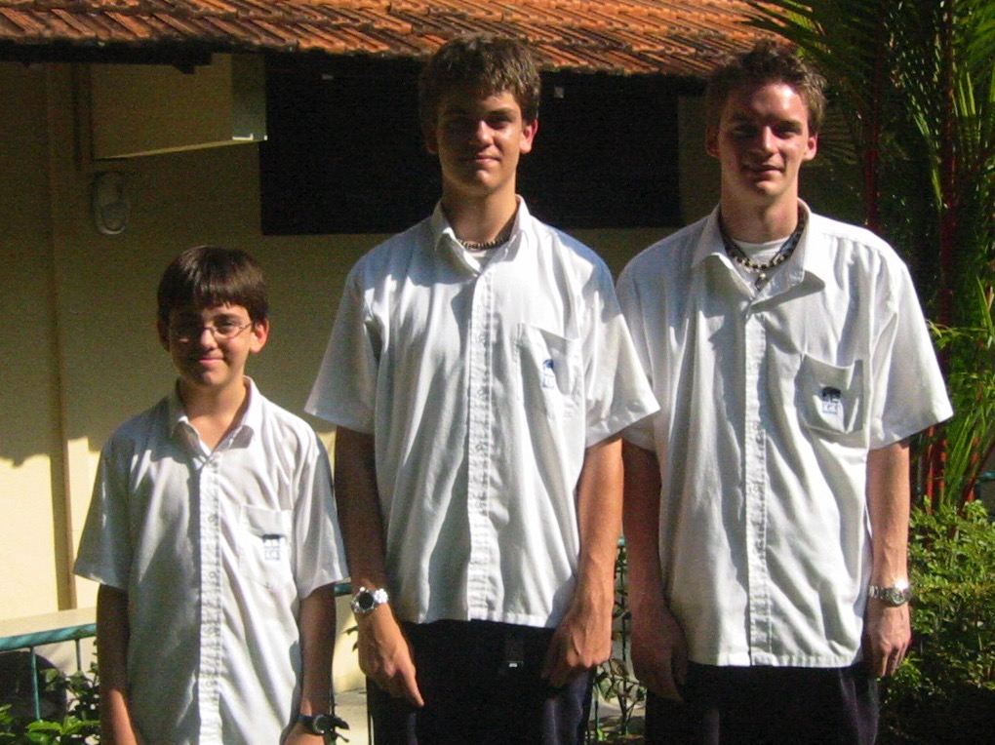
God healed him through the James 5 process
April 2005

Slide 59
What should you do?
James 5

Slide 60

Joni Eareckson
Notes:
Wikipedia accessed 21 April 2016
Joni Eareckson Tada (born October 15, 1949) is an evangelical Christian,^{[1]} author, radio host, and founder of Joni and Friends, an organization "accelerating Christian ministry in the disability community.”
Biography
Tada was born in 1949 in Baltimore, Maryland, the youngest of four daughters.[citation needed][2][not in citation given]
As a teenager, Tada enjoyed riding horses, hiking, tennis, and swimming. On July 30, 1967, she dove into Chesapeake Bay after misjudging the shallowness of the water. She suffered a fracture between the fourth and fifth cervical levels and became a quadriplegic, paralyzed from the shoulders down.^{[3]}
During her two years of rehabilitation, according to her autobiography, she experienced anger, depression, suicidal thoughts, and religious doubts. However, Tada learned to paint with a brush between her teeth, and began selling her artwork. To date, she has written over forty books, recorded several musical albums, starred in an autobiographical movie of her life, and is an advocate for disabled people.^{[4]}
Tada wrote of her experiences in her 1976 international best-selling autobiography, Joni: The unforgettable story of a young woman's struggle against quadriplegia & depression, which has been distributed in many languages. The book was made into a 1979 feature film of the same name, starring herself. Her second book, A Step Further, was released in 1978.
She married Ken Tada in 1982. They live in Calabasas, California. In 2010, she announced that she had been diagnosed with breast cancer. She emerged successfully from cancer surgery and is hopeful of a positive prognosis.
Ministry and public life
Tada founded Joni and Friends (JAF) in 1979, an organization for Christian ministry in the disabled community throughout the world. In 2006 the Joni and Friends International Disability Centre in Agoura California was established.^{[citation needed]}
Led by Tada and Doug Mazza, the Joni and Friends International Disability Center has four programs. Joni and Friends, a daily five-minute radio program, heard in over 1,000 broadcast outlets. In 2002 it received the “Radio Program of the Year” award from National Religious Broadcasters. The Wounded Warrior program offers family retreats. Wheels for the World collects wheelchairs, which are refurbished by prison inmates and donated to people in developing nations where, physical therapists fit each chair to a needy disabled child or adult.
In 2005, Tada was appointed to the Disability Advisory Committee of the U.S. State Department.
Tada is a conference speaker. Her articles have been published in Christianity Today, Today's Christian Woman, The War Cry (Salvation Army), and newspapers around the world. Tada has appeared four times on Larry King Live.
In November 2009, Tada signed an ecumenical statement known as the Manhattan Declaration calling on evangelicals, Catholics and Orthodox Christians to work towards changing laws which permit abortion, and other matters that go against their religious consciences.^{[5]}

Slide 61

Joni Eareckson Tada

Slide 62
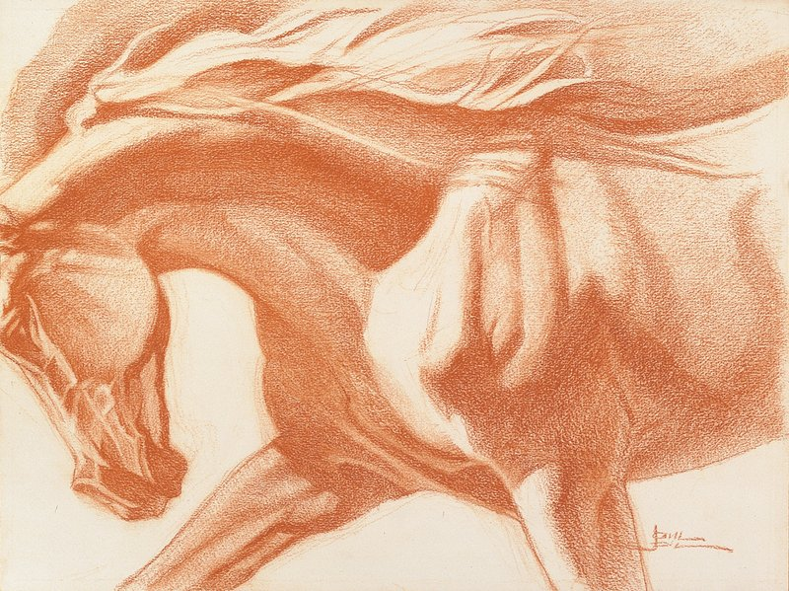
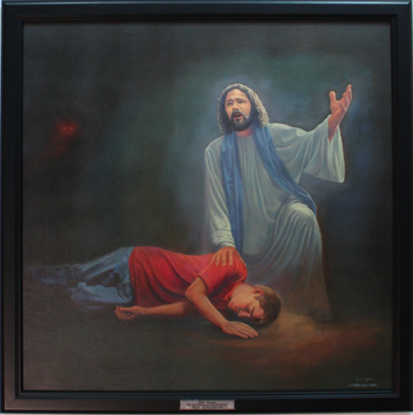
Joni Eareckson Tada

Slide 63
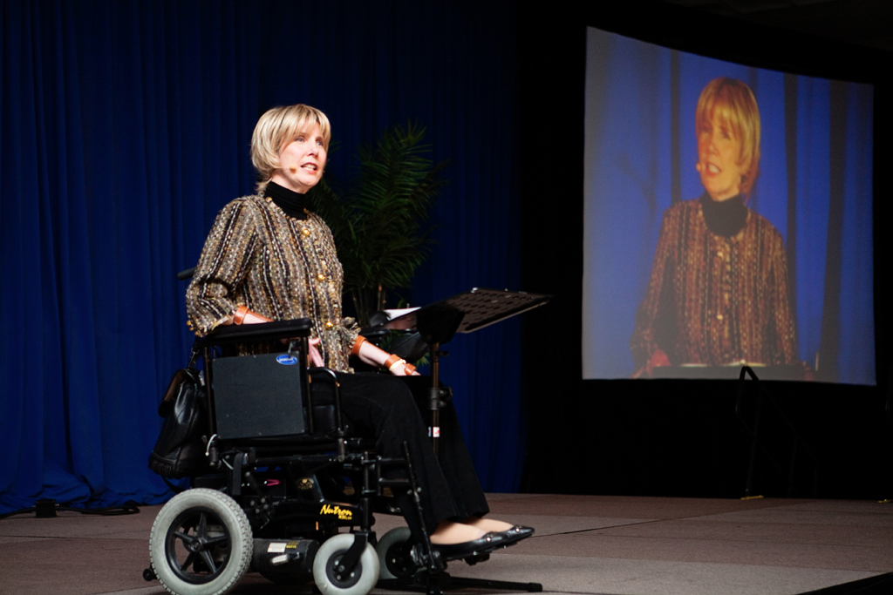
Joni Eareckson Tada

Slide 64
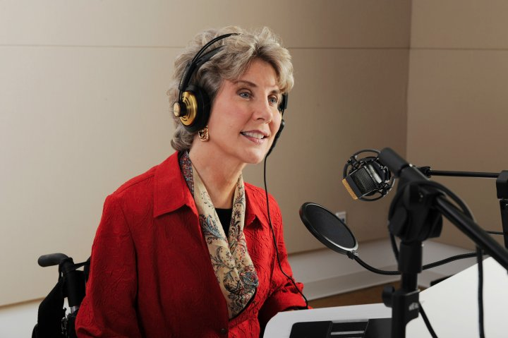
Joni Eareckson Tada

Slide 65
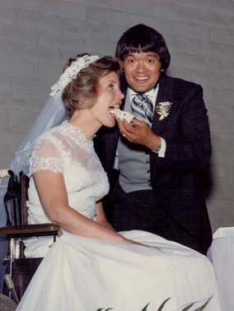
Joni and Ken were married in 1982 at Grace Community Church in Sun Valley, California.

Slide 66
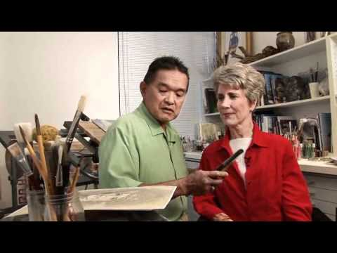
Joni Eareckson Tada

Slide 67

Is healing our right as believers?
27
Joni Eareckson Tada

Slide 68
Spiritual Gifts…
The Gift of Tongues Examined

Slide 69
How Did Today's Readings Change Your Thinking on Tongues?
What was your understanding before doing the assignment?
What is your understanding now?

Slide 70
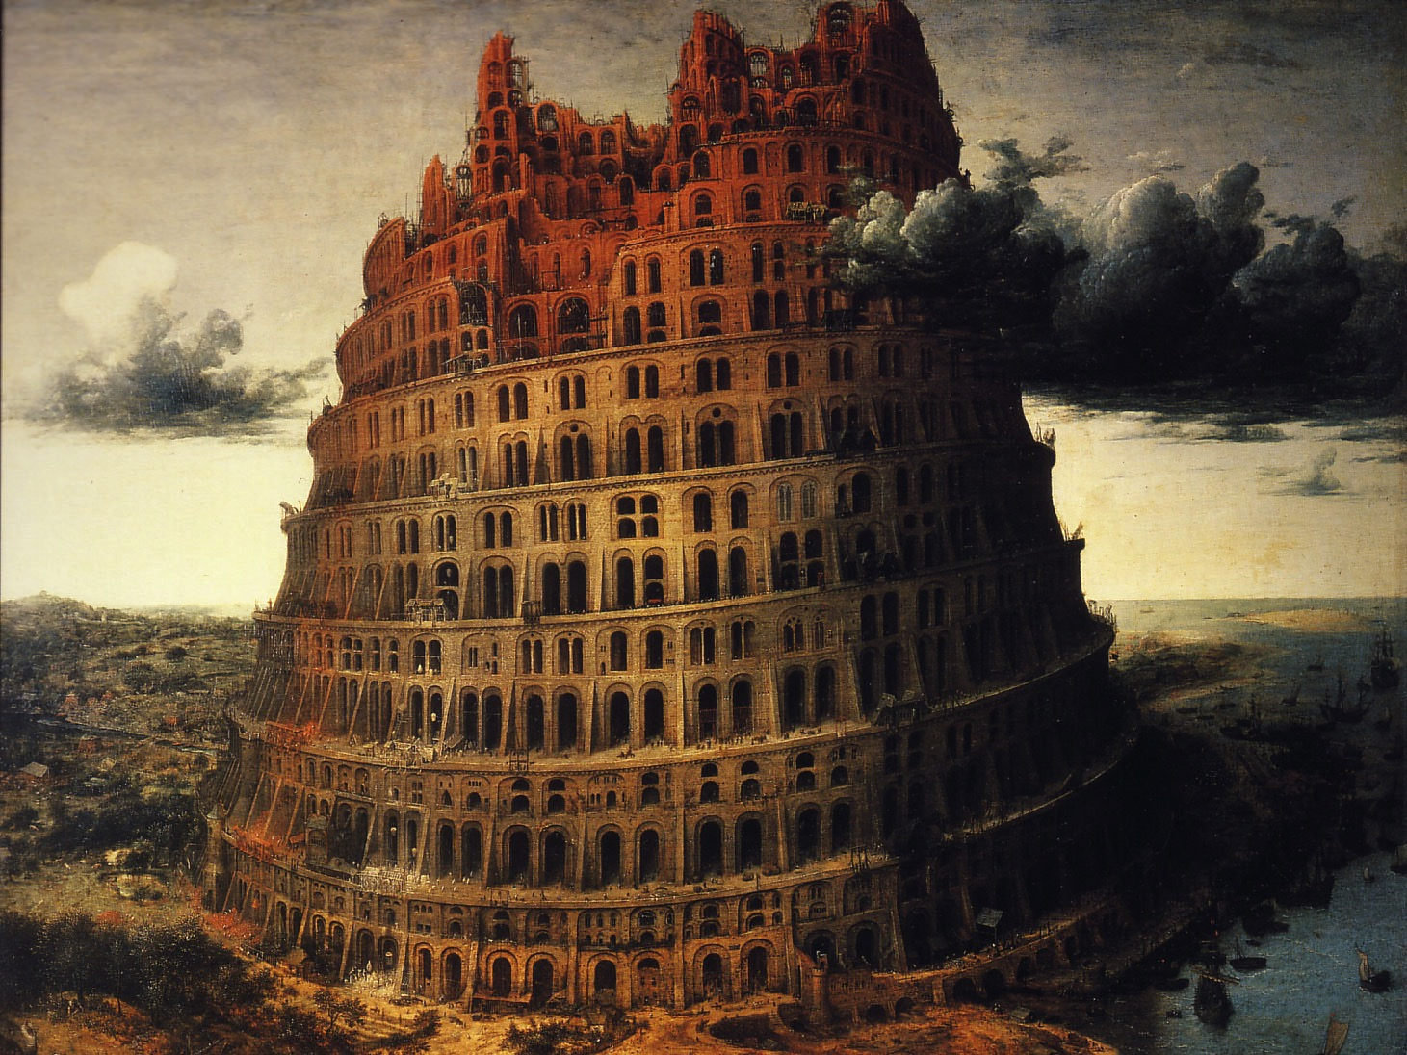
Is tongues a heavenly language?
“If I speak with the tongues of men and of angels, but have not love, I am a noisy gong and a clanging cymbal” (1 Cor. 13:1)

Slide 71
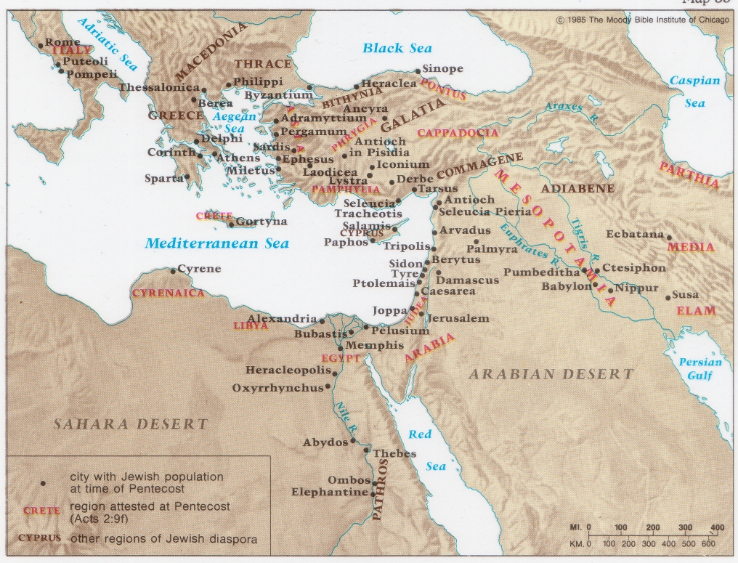
The Jewish Diaspora at Pentecost
132

Slide 72
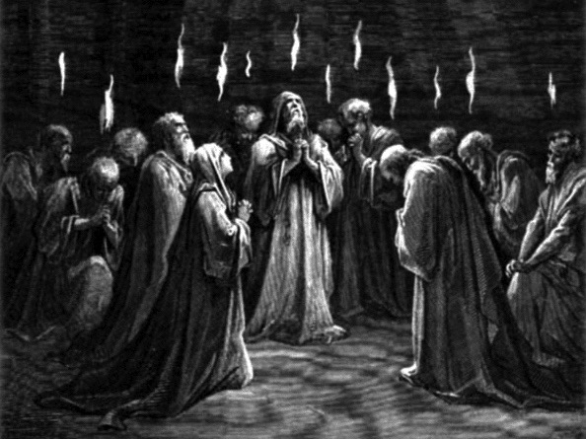
The Spirit Came at Pentecost (Acts 2)

Slide 73
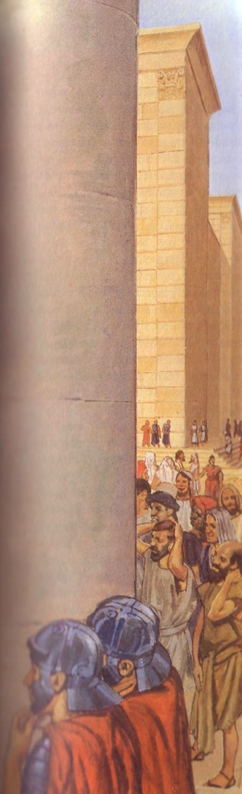
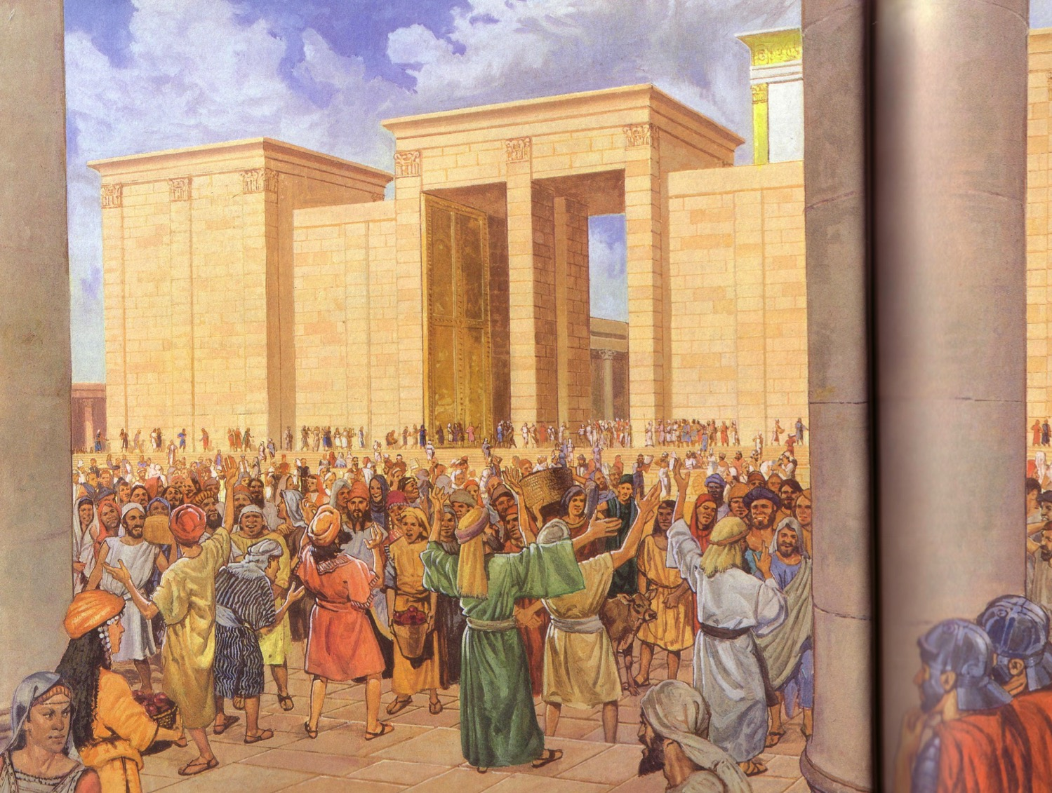
Apostles praised God in languages they had never learned (Acts 2)
Egyptian
Persian
Arabic
Median
Latin
Etc.

Slide 74
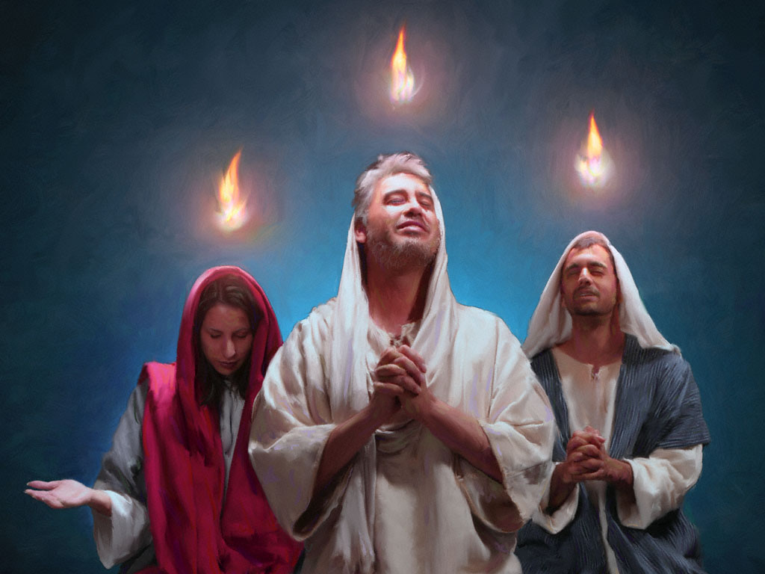
Pentecost (Acts 2) was a Corporate Indwelling

Slide 75
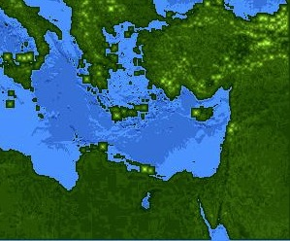
Jews at Pentecost––Acts 2:9-11
132
Rome (13)
PONTUS (7)
CAPPADOCIA (6)
ASIA (8)
PHRYGIA (9)
Parthia (1)
PAMPHILIA (10)
Mesopotamia (4)
CRETE (14)
Media (2)
Elam (3)
Jerusalem
CYRENE (12)
JUDEA (5)
ASIA––Roman Empire Provinces
Media––Parthian Empire Provinces
EGYPT (11)
Rome––Cities
CRETE––Islands
ARABIA (15)
Miles
0
200
400
600
800
1000
(1) (2) (3) etc. indicate sequence in Acts 2:9-11
Kms
0
300
600
900
1200
1500
Notes:
Jews numbered 40,000 in Rome during the reign of Augustus (30 BC to AD 14), so this was a sizable minority. We do not know for sure who actually started the church at Rome, but it likely was some of these Jews who returned to Rome after receiving the Spirit at Pentecost in Jeruslem. They, in turn, led Gentiles in Rome to faith as well.

Slide 76
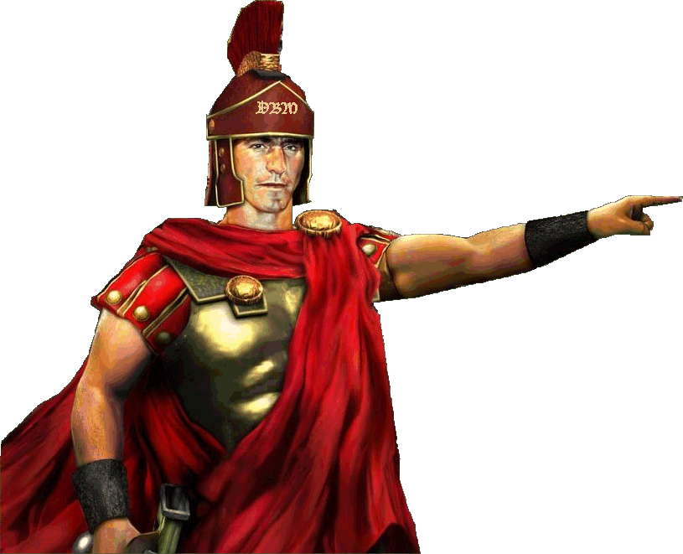
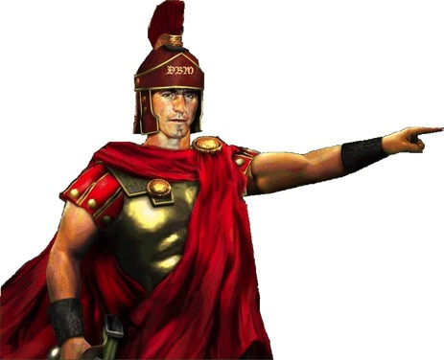
Cornelius (Acts 10)
Alms & prayers
Vision

Slide 77
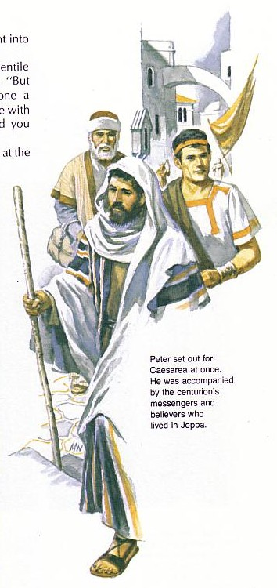
“What's God going to do to these unclean men?”
Peter must have wondered why God wanted him to go with the servants of Cornelius

Slide 78
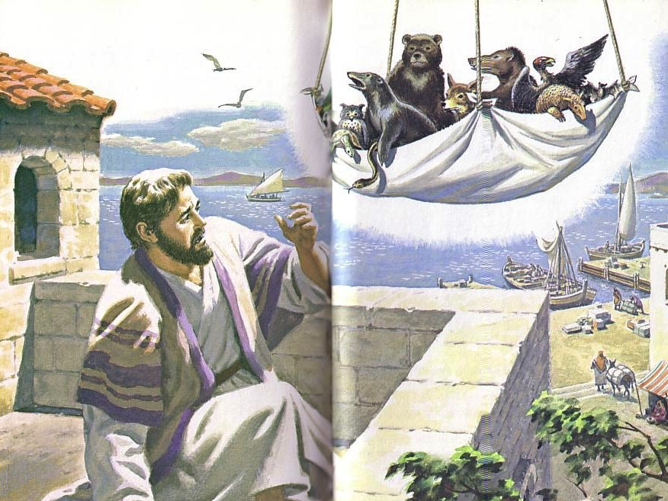
“Get up, Peter! Kill and eat!”
Peter Prepared
  Eat “unclean” food (Acts 10:8-16)
    The sheet “contained all kinds of four-footed animals, as well as reptiles of the earth and birds of the air” (10:12)

Slide 79

God's initiation
God involved Peter in Cornelius's conversion to confirm to the Jewish church that God was doing a new thing (Acts 10:17-44)

Slide 80
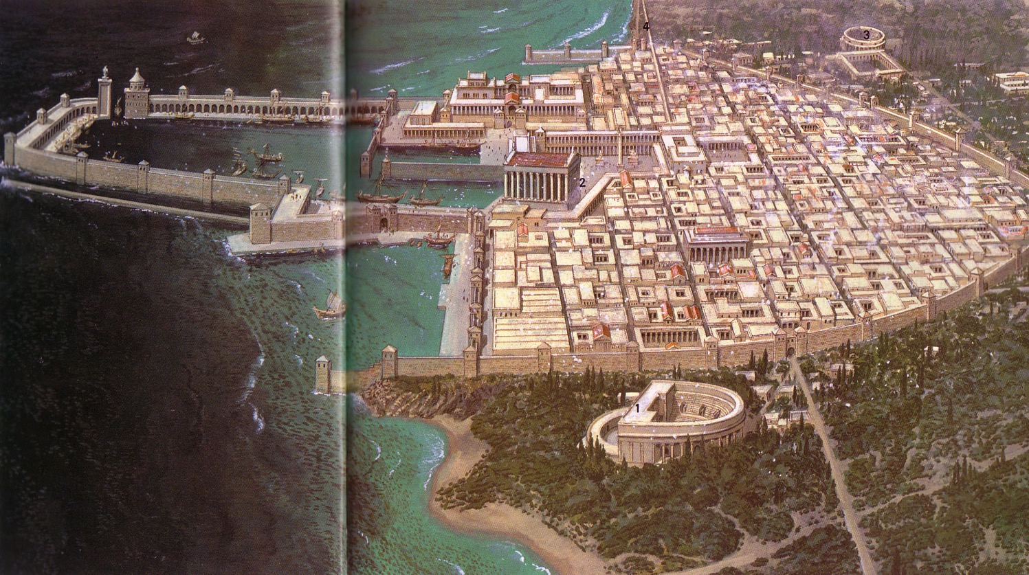
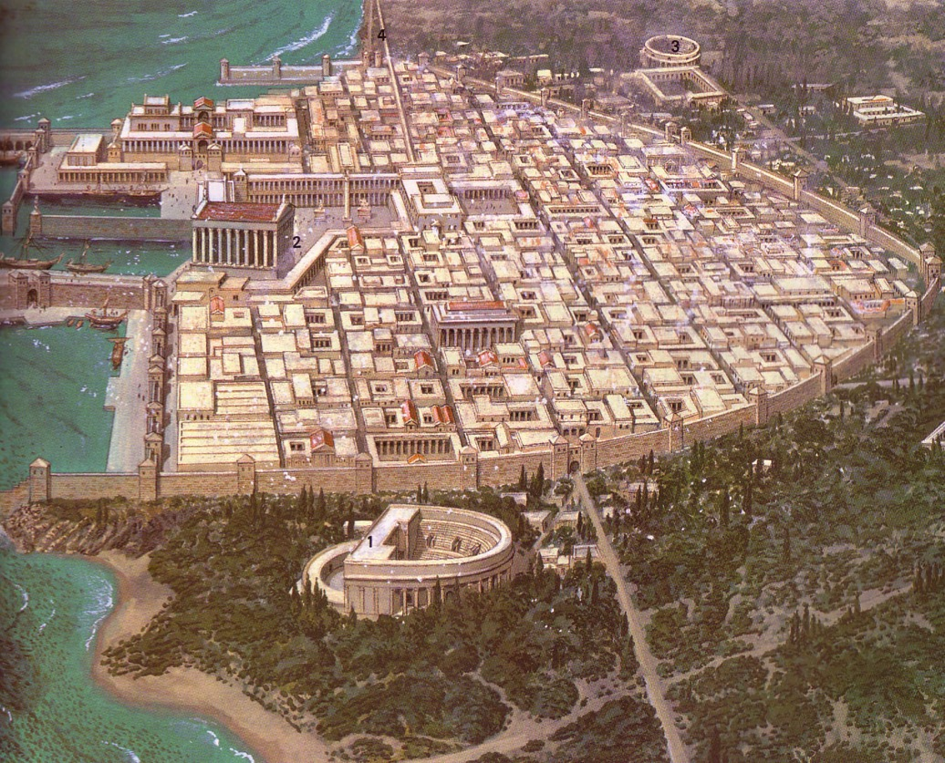
Caesarea: Loved and Despised
Notes:
Romans loved Caesarea, considering it a model city.
Jews despised it as the unclean capital of their conquerors
Yet Peter willingly went there as he saw God initiating change!

Slide 81

Peter's Response
“I most certainly understand now that God is not one to show partiality, but in every nation the man who fears Him and does what is right, is welcome to Him”
(Acts 10:34–35).

Slide 82
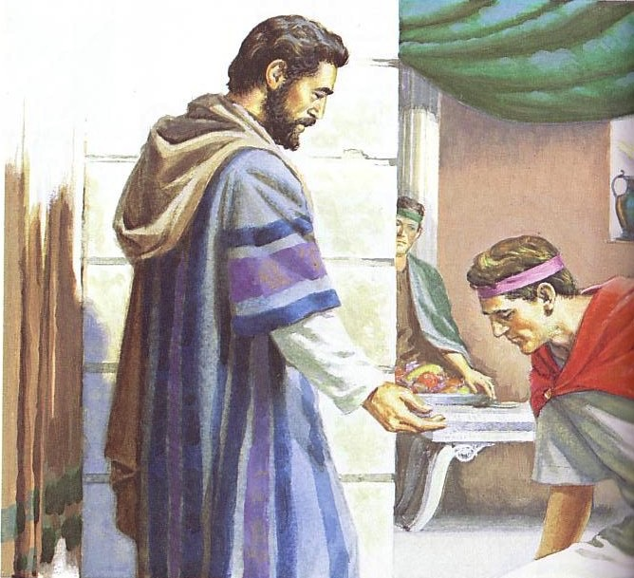
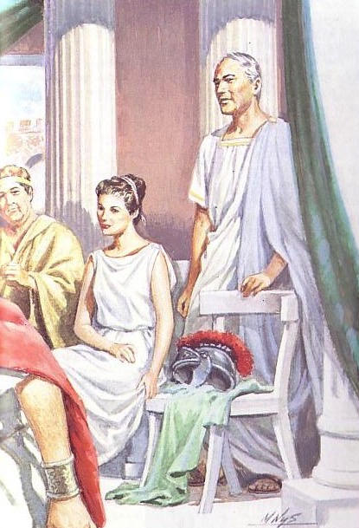
God gave his Spirit to Cornelius

Slide 83

Speaking in Tongues in Acts
32
(Toussaint, Bible Knowledge Commentary, 2:408, adapted)
Text | Speakers | Audience | Related to Salvation | Purpose
2:1-4 | Apostles+ | Unsaved Jews at Pentecost | After salvation | Validate for Jews the fulfillment of Joel 2
8:14-17 | Samaritans | Saved Jews doubting God's plan (Peter+) | After salvation | Validate for Jews God's acceptance of Samaritans
10:44-47 | Gentiles (Cornelius+ others) | Saved Jews doubting God's plan (Peter+) | At salvation | Validate for Jews God's acceptance of Gentiles
19:1-7 | OT believers in Messiah | Jews needing gospel message confirmed | At salvation | Validate for Jews God's message through Paul
Notes:
Tongues were NOT a pattern even in the book of Acts, let alone today. Sometimes people spoke in tongues AT salvation while other times they spoke AFTER salvation.

Slide 84
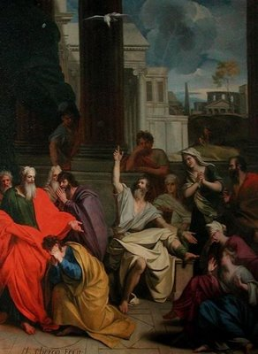
I. Prophecy benefits other believers
(1 Cor. 14:2-5)
Notes:
84

Slide 85

A. Prophecy is understood by others while tongues is understood only by God (1 Cor. 14:2-3).
²For if you have the ability to speak in tongues, you will be talking only to God,
since people won't be able to understand you. You will be speaking by the power of the Spirit, but it will all be mysterious.
³But one who prophesies strengthens others, encourages them, and comforts them (NLT).
Notes:
85

Slide 86
Tongues Comparisons
33
Tongues in… | Acts | 1 Corinthians
Both were known foreign languages | Languages of the Roman world were spoken (Acts 2:7-11) | The same word (glossa) is used, so the nature of the gift is the same (Rom. 3:13; 14:11; Phil. 2:11 all refer to intelligible speech)
Both functioned as a sign to unbelievers | Listeners were exhorted to receive forgiveness (Acts 2:38) | Unbelievers in the assembly needed translation for blessing (1 Cor.14:21-22)
Both have God as the Source rather than self | The tongues speakers were not trying to get the gift (Acts 2:2) | Tongues is among the gifts of the Spirit (1 Cor. 12–14)
Notes:
86

Slide 87
Tongues Contrasts
33
Tongues in… | Acts | 1 Corinthians
Speaker's Control | Uncontrolled | Controlled
Recipients | Groups only | Gifted individuals
Phenomenon | Wind and fire (Acts 2:2) | None
Times per person | One time | Repeated
Those who understand | Native speakers | Those gifted in interpretation
Dates | AD 33-53 (Acts 2-19) | AD 56
When occurred | Generally at salvation | After salvation
Use | Always used properly | Often abused
Restrictions | None | Some: only 2-3 per service, each in turn, need interpreter (1 Cor. 14:27)
Notes:
87

Slide 88
B. Prophecy edifies the church while tongues only edifies the speaker (1 Cor. 14:4-5).
⁴A person who speaks in tongues is strengthened personally, but one who speaks a word of prophecy strengthens the entire church.
⁵I wish you could all speak in tongues, but even more I wish you could all prophesy. For prophecy is greater than speaking in tongues, unless someone interprets what you are saying so that the whole church will be strengthened (NLT).
Notes:
88

Slide 89
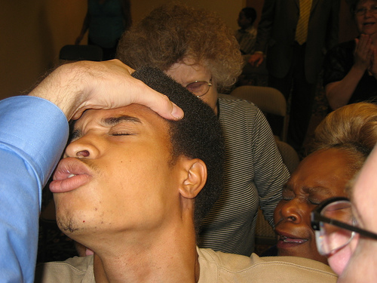
II. Uninterpreted tongues are incomprehensible (1 Cor. 14:6-19)
Notes:
89

Slide 90
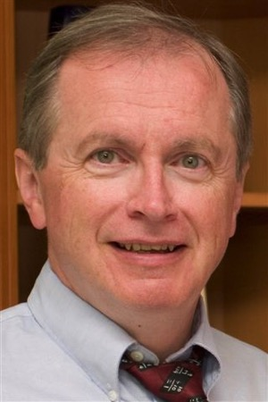
Modern Tongues are Not Languages
“To my knowledge there is universal agreement among linguists who have taped and analyzed thousands of examples of modern tongues-speaking that the contemporary phenomenon is not any human language.
“The patterns and structures that all known languages require are simply not there. Occasionally a recognizable word slips out; but this is statistically likely, given the sheer quantity of verbalization.”
D. A. Carson, Showing the Spirit, 83
Notes:
90

Slide 91
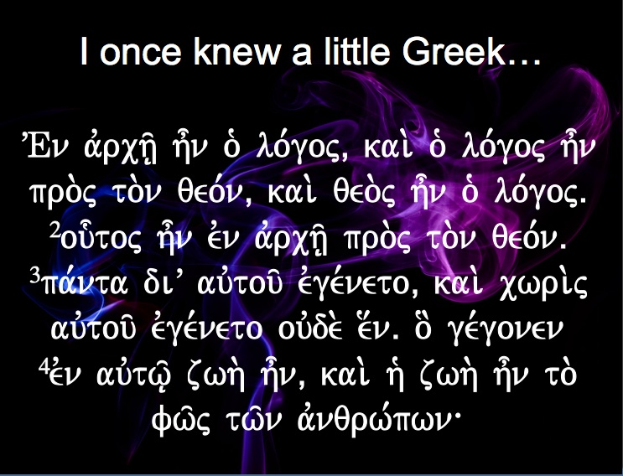

I once knew a little Greek…
VEn avrch/| h=n o` lo,goj( kai. o` lo,goj h=n pro.j to.n qeo,n( kai. qeo.j h=n o` lo,gojÅ
²ou-toj h=n evn avrch/| pro.j to.n qeo,nÅ
³pa,nta diV auvtou/ evge,neto( kai. cwri.j auvtou/ evge,neto ouvde. e[nÅ o] ge,gonen
⁴evn auvtw/| zwh. h=n( kai. h` zwh. h=n to. fw/j tw/n avnqrw,pwn\

Slide 92
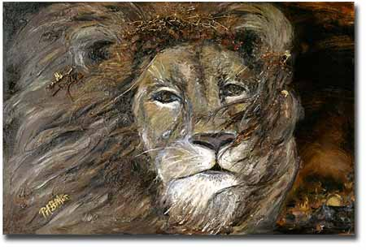
III. Prophecy has a superior purpose and results (1 Cor. 14:20-25).
Notes:
92

Slide 93
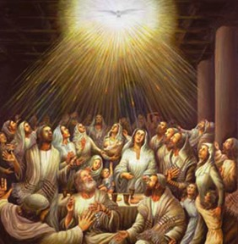
A. Prophecy has a superior purpose (1 Cor. 14:20-22).
Far superior is prophecy, for prophecy edifies believers (22b)
Tongues authenticate God's work to unbelievers (21-22a)
Notes:
93

Slide 94
Purpose for Unbelievers (especially Jews)
In the Law it is written:
"Through men of strange tongues and through the lips of foreigners I will speak to this people [Jews], but even then they will not listen to me," says the Lord
[Isa. 28:11].
Tongues, then, are a sign, not for believers but for unbelievers;
prophecy, however, is for believers,
not for unbelievers.
1 Cor. 14:21-22
Notes:
94

Slide 95
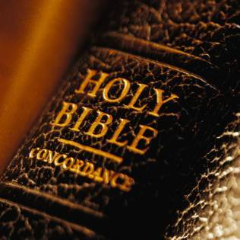
A Biblical Definition of Tongues
29
"The God-given ability to speak divine revelation in a foreign language by the speaker to unbelieving Jews in their language (as a sign) that a gifted interpreter can translate to edify the church"
Notes:
95

Slide 96
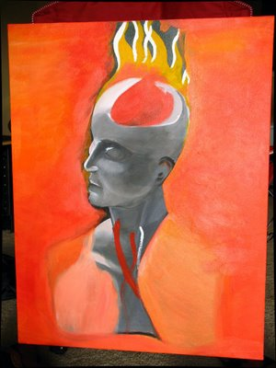
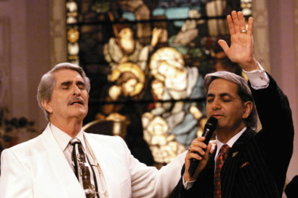
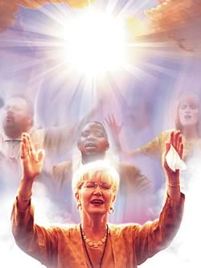
Today:
Real Languages?
For Unbelievers?
Notes:
96

Slide 97

Why can't tongues be a special prayer language?
31
Edifies others (1 Cor. 14:26)
For unbelievers (14:22)
Not understood (14:14-15)
Limited to some (12:30)
Interpretation required (14:26-28)
Keep quiet in the church (14:28)
Outside church as a sign (14:20)

Slide 98
A. Prophecy has a superior purpose (1 Cor. 14:20-22).
Far superior is prophecy, for prophecy edifies believers (22b)
Tongues authenticate God's work to unbelievers (21-22a)
Notes:
98

Slide 99
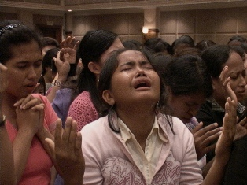
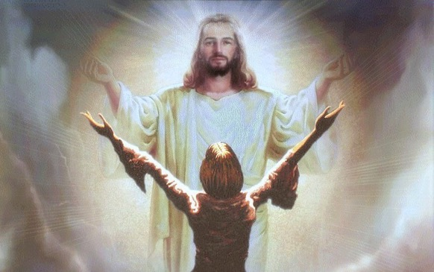
B. Prophecy has superior results (1 Cor. 14:23-25).
But prophecy brings conviction, repentance, and worship for unbelievers in the assembly (24-25)
Uninterpreted tongues turns off unbelievers in the assembly (23)
Notes:
99

Slide 100

God's Word must have the highest priority in public worship (Main Idea)
Home group
Take notes
Bring a Bible
"No Bible,
no breakfast"

Slide 101

Scriptural References on Tongues:
Acts 2:1-13 Pentecost Jews
Acts 10:44-47; 11:15-18 Cornelius
Acts 19:1-7 John's Disciples
1 Cor. 12–14 Misuse of Tongues

Slide 102

Six General Observations:
1. Speaking in tongues is a sign of salvation (no unbeliever can genuinely speak in tongues).
Mark 16:17 "These signs will accompany those who have believed: in My name they will cast out demons, they will speak with new tongues; ¹⁸they will pick up serpents, and if they drink any deadly poison, it will not hurt them; they will lay hands on the sick, and they will recover."

Slide 103
Sign of salvation (continued)
Acts 10:44 While Peter was still speaking these words, the Holy Spirit fell upon all those who were listening to the message. ⁴⁵All the circumcised believers who came with Peter were amazed, because the gift of the Holy Spirit had been poured out on the Gentiles also. ⁴⁶For they were hearing them speaking with tongues and exalting God. (The beginning of Acts 10 records that Cornelius is already a God-fearing who prays to God daily.)
Acts 19:5 When they heard this, they were baptized in the name of the Lord Jesus. ⁶And when Paul had laid his hands upon them, the Holy Spirit came on them, and they began speaking with tongues and prophesying.

Slide 104
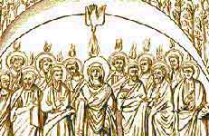
2. Tongues is a manifestation and empowerment of the Holy Spirit.
Acts 2:4 And they were all filled with the Holy Spirit and began to speak with other tongues, as the Spirit was giving them utterance.
Acts 19:6 And when Paul had laid his hands upon them, the Holy Spirit came on them, and they began speaking with tongues and prophesying.

Slide 105
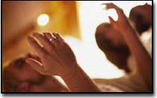
3. Tongues exalt God and pray to him.
Acts 2:11 Cretans and Arabs-- we hear them in our own tongues speaking of the mighty deeds of God.
Acts 10:46 For they were hearing them speaking with tongues and exalting God.
1 Cor. 14:27 If anyone speaks in a tongue, it should be by two or at the most three, and each in turn, and one must interpret; ²⁸but if there is no interpreter, he must keep silent in the church; and let him speak to himself and to God.

Slide 106

4. It is given for the common good of the church/believers.
1 Cor. 12:7 But to each one is given the manifestation of the Spirit for the common good.

Slide 107
5. It supports evangelism as a sign to direct others to Christ.
Acts 2:14 But Peter, taking his stand with the eleven, raised his voice and declared to them: "Men of Judea and all you who live in Jerusalem, let this be known to you and give heed to my words. ¹⁵"For these men are not drunk, as you suppose, for it is only the third hour of the day; ¹⁶but this is what was spoken of through the prophet Joel… [then 3000 were saved from Peter's preaching].
(Acts 2:14-41)

Slide 108

6. It is not a gift for every believer.
1 Cor. 12:30
All do not have gifts of healings, do they?
All do not speak with tongues, do they?
All do not interpret, do they?

Slide 109
7. It is a sign to unbelievers.
Acts 2:6 And when this sound occurred, the crowd came together, and were bewildered because each one of them was hearing them speak in his own language. ⁷They were amazed and astonished, saying, "Why, are not all these who are speaking Galileans? ⁸"And how is it that we each hear them in our own language to which we were born?"
1 Cor. 14:22 So then tongues are for a sign, not to those who believe but to unbelievers; but prophecy is for a sign, not to unbelievers but to those who believe.

Slide 110
8. It is one of the few gifts with limitations placed up on it (1 Cor. 14).
No more than 3 may speak per service (14:27a)
Each must speak in turn--never at the same time (14:27b)
If no interpreter is present, then no one may speak in tongues (14:28)
Tongues are only to be spoken by men (14:34-35)

Slide 111
Tongues versus Prophecy
34
 | Tongues | Prophecy
Value | Inferior (14:5a) | Superior (14:1)
Relation to Other Gifts | The least important gift (12:28) | The second most important gift (12:28)
Language Used | Foreign (14:10) | Vernacular (14:19)
Corollary Gift | Interpretation of tongues (12:30; 14:27-28) | Discerning of spirits (12:10; 14:29)
Speaker's Knowledge of Language | Unknown: "utters mysteries with his spirit…my spirit prays but my mind is unfruitful" (14:2b, 14) | Known: "pray with my spirit [and] with my mind" (14:15, 19)
Notes:
111

Slide 112
Tongues versus Prophecy
34
 | Tongues | Prophecy
Value (without Interpretation) | Harmful: people cannot understand and thus are not edified (14:16-17, 23, 28) | Great: people can understand and thus are edified (14:5b, 24-25)
Edification (without Interpretation) | Self only (14:4a; cf. 10:24; 12:7, 11) | Entire church (14:4b)
Direction of Speech is to… | God (14:2) | Men (14:3)
Result in Others | Revelation, knowledge, prophecy, word of instruction (14:6) | Strengthening, encouragement, and comfort (14:3b)
Notes:
112

Slide 113
Tongues versus Prophecy
34
 | Tongues | Prophecy
Type of Communication | Speaking (14:6), prayer (14:14), praise (14:16), singing? (14:15b) | Foretelling the future, "forthtelling" or declaring doctrinal truth (14:19)
Purpose | Sign to unbelieving Jews (14:21-22a) | Message to believers (14:22b)
Limitations | Two or three tongues messages in each service (14:27a), speak in turn (14:27b), someone must interpret (14:27c-28) | Two or three prophetic messages in each service (14:29a), speak in turn (14:30-31), someone must discern (14:29b, 32)
Notes:
113

Slide 114
Tongues versus Prophecy
34
 | Tongues | Prophecy
Exhortation | Negative: Do not forbid tongues (14:39b) | Positive: Be eager to prophesy (14:39a)
Agent of Cessation | Self: middle voice (13:8b) | Someone other than self: passive voice (13:8a)
Notes:
114

Slide 115
Phrases Used for Tongues:
glw,ssaij kainai/j
(Mark 16:17, translated "new tongues").
e`te,raij glw,ssaij
(Acts 2:4, translated "other tongues"): In the latter part of the passage, we see that these "other tongues" were known languages (2:8-11), yet they were unknown to those who uttered them.

Slide 116

Phrases Used for Tongues:
ge,nh glwssw/n
(1 Cor. 12:10, 28, translated "various kinds of tongues")
tai/j glw,ssaij tw/n avnqrw,pwn kai. tw/n avgge,lwn
(1 Cor. 13:1, "tongues of men and of angels")

Slide 117


Different Views:
Non-Cessationist
Agnes Ozman
Cessationist
Once people have been mentally conditioned by a Charismatic environment, …Charismatic practices loosen up the mind in such an unhealthy way that people will believe almost anything.
(John MacArthur; http://www.biblebb.com/files/MAC/CHAOS7.HTM)

Slide 118

Cessation of All Supernatural Gifts
The 9 Supernatural Gifts of the Holy Spirit Ceased
The New Testament replaced the scaffolding of the nine spiritual gifts shortly after AD 96
Infant Church: AD 33-96
Mature Church: AD 96—present
Two Purposes
1. Confirm
2. Edify
Temporary Scaffolding
8&9 Tongues & Interp.
6. Prophecy
7. Miracles
TILL WE ALL ATTAIN
Eph 4:13
1 Cor 13:8-13
Bible Finished: 27 NT Books
5. Distinguishing Spirits
4. Knowledge
There is no need or purpose for the nine spiritual gifts today: The Bible is all-sufficient!
2. Faith
3. Healing
1. Wisdom
Nine Supernatural Gifts: 1 Cor 12
www.bible.ca
Apostle
Adapted from Steve Rudd at http://www.bible.ca/tongues-9-spiritual-gifts-defined.htm

Slide 119
True versus False Tongues:
By J. Hurt, Steve Rudd (http://www.bible.ca/su-tongues-today.htm)
First Century | Today
Spoke a known language (Acts 2:8) | Don't even claim to use known languages
Were understood (Acts 2:6; 1 Cor. 14:19) | Don't claim to understand today
Were edified (1 Cor. 14:26) | No such claim today
Spoke by turn (1 Cor. 14:27) | All speak together today in mass confusion
No interpreter led to silence (1 Cor. 14:28) | Don't want to be interpreted today

Slide 120

True versus False Tongues
First Century | Today
Sign to unbelievers (1 Cor. 14:22) | Used for excitement
Purpose was to edify (1 Cor. 14:26) | Purpose is to entertain (for show)
Prayed for interpretation (1 Cor. 14:13) | Pray for tongue speaking
Real Human Language (Acts 2:8) | Total Gibberish and Nonsense
Emphasis on Public Demonstration | Emphasis on Private Devotion
J. Hurt, Steve Rudd
(http://www.bible.ca/su-tongues-today.htm)

Slide 121
A Clarification:
Larry Christenson writes, "What God has established does not need to be defended nor can it be downgraded. Our task is… to discover the purpose and meaning which God has in mind when He appointed the gift for His Church." He adds that the gift of tongues has been abused in the present day, which is what Paul was warning the Corinthians (1 Cor. 14). "Scripture simply does not support an argument against speaking in tongues—only against its abuse." Thus we "cannot depreciate the gift" based on its abuse since the gift is of the Holy Spirit.
DIVINE MANIFESTATION OR HUMAN CONSPIRACY?

Slide 122
Conclusion
The "perfect" in 1 Cor. 13:10 when tongues are "stilled" (v. 8), refers to the maturity of the body of Christ, which happened at the completion of the canon (see notes, 17).
If the biblical view of tongues is applied today (interpreted for Jewish unbelievers) then the great majority of supposed tongues are not valid.

Slide 123
Black

Slide 124
By Jacob, Ivan, Karsun & Kenneth

Slide 125
Spiritual Gifts…
The Gift of Tongues Examined
Adapted significantly from:
Josephine Tan
18 Feb 2005
(Some views are the opposite of her presentation)

Slide 126

Holy Spirit PPT link at BibleStudyDownloads.org
Get this presentation for free!

Slide 127
Black

